Slide 1

CAPITAL MARKET TOOLKIT
Data Visualization Project
By Chenghao Han

Slide 2


Introduction
PURPOSE:
Help people with limited knowledge about the capital market make sense of all the complicated financial data, such as stock prices, company valuations and foreign exchange rates.
Provide the users with necessary analysis to help them make investment decisions.
Data Source:
Yahoo Finance
Financial Modeling Prep
Programming Language:
JavaScript
HTML/CSS

Slide 3
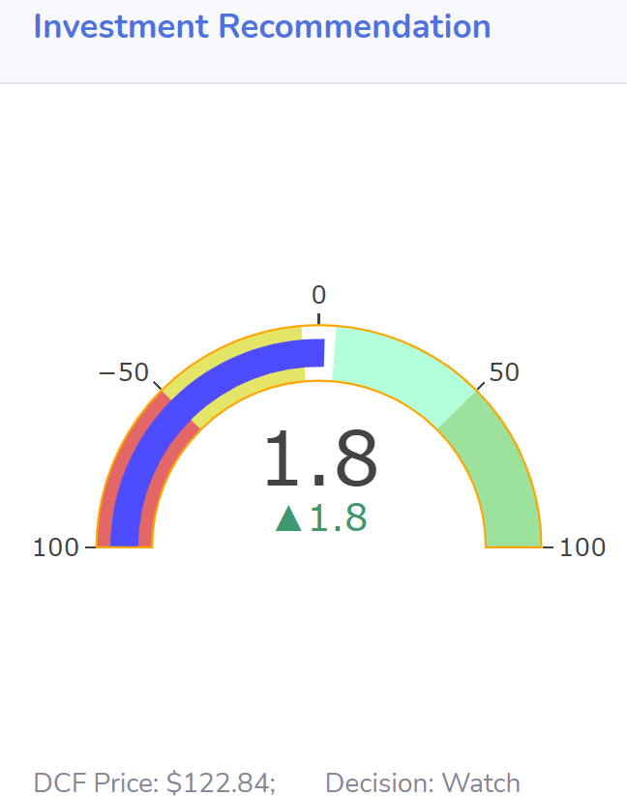
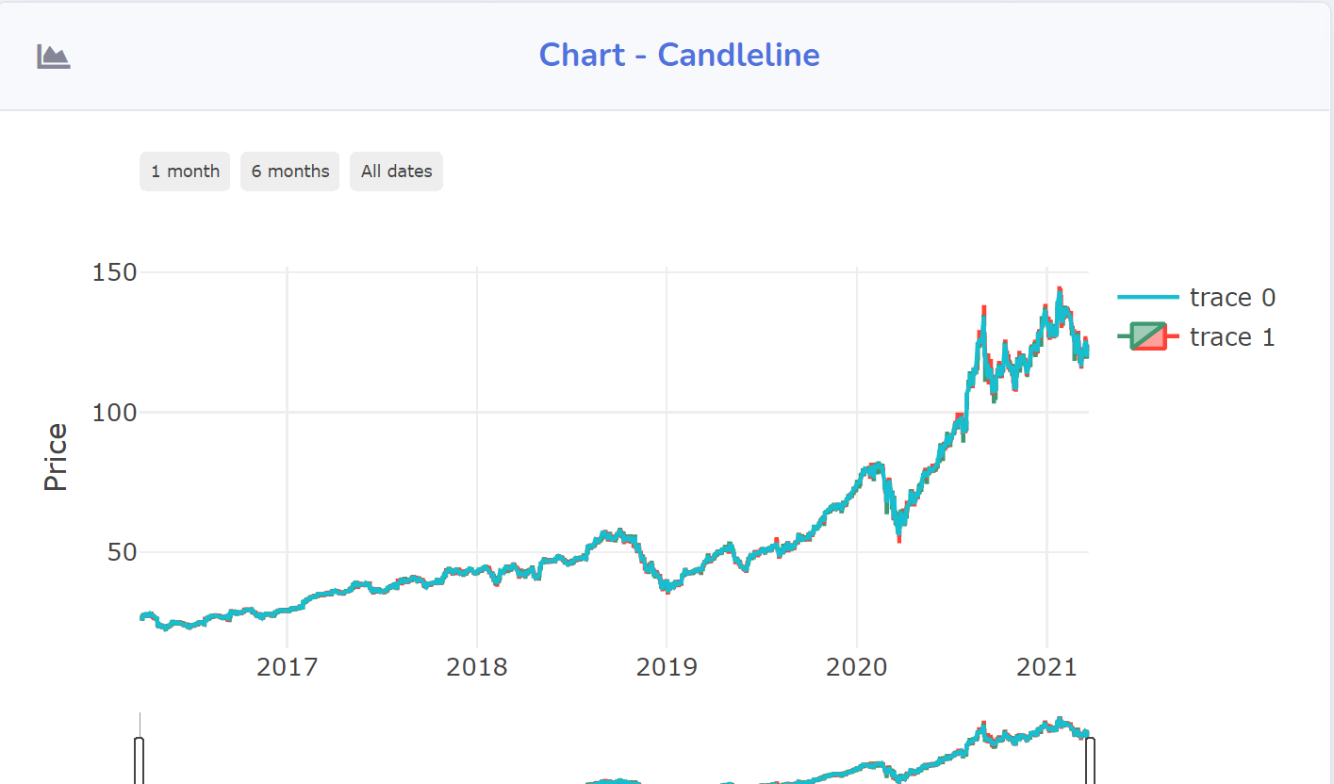
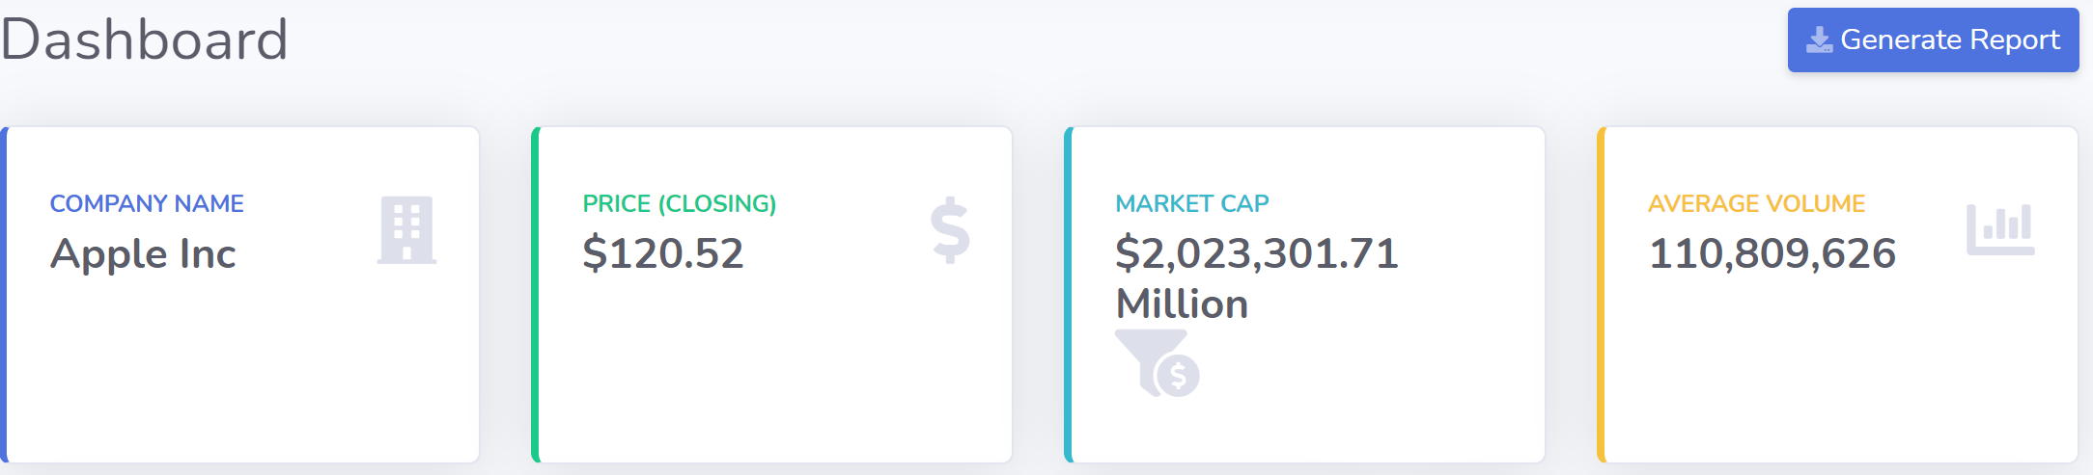
Dashboard
Users can search all the listed stocks on the stock market and select the specific stock they are interested in on this page.
Once the selection has been made the application will display candlesticks graphs, stock summary, statistics etc.
The gauge graph will provide current valuation price based on the DCF model and give an investment recommendation.

Slide 4
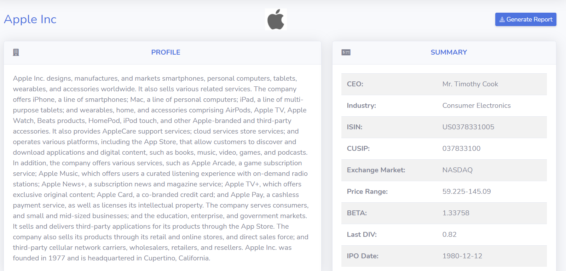
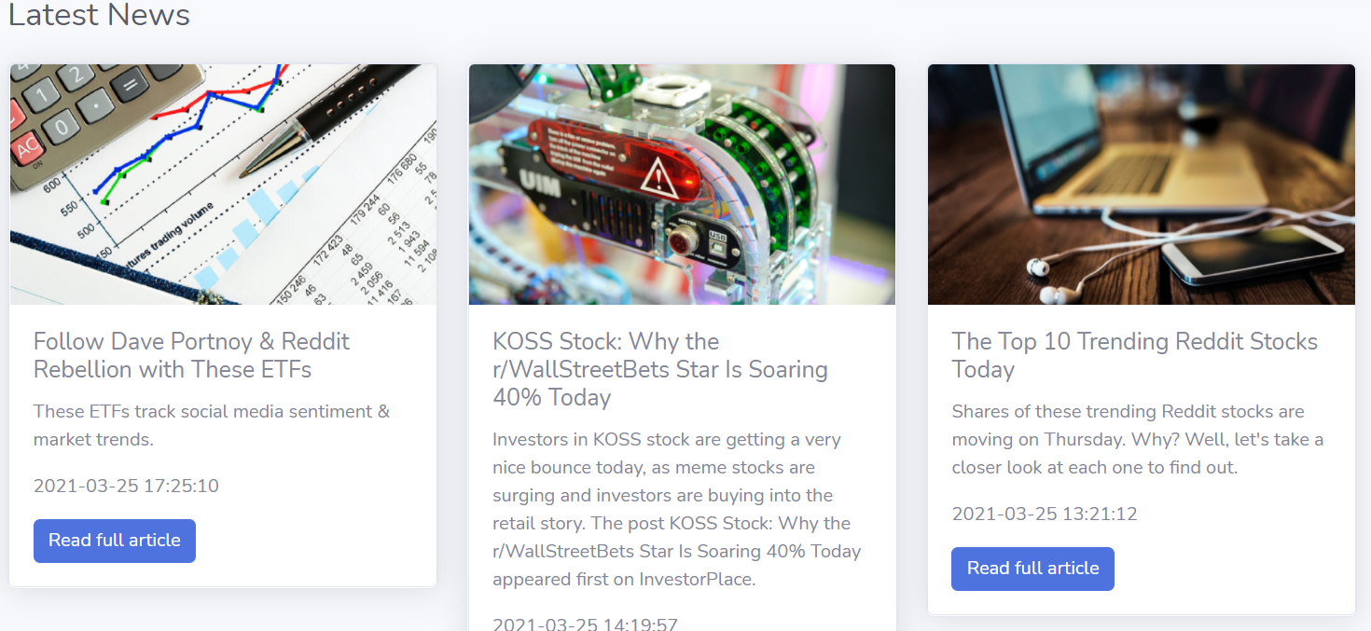
Company Information
Users can find detailed company information here. There will be a full intro to the company on this page.
A summary card will show company’s CEO, codes, and key financials indicators.
Users can jump into the official company website by clicking the company name.
Latest New section allows users to check three most recent news that relate to the company.
These new are related to the company or industry and will be useful when investors to make an investment decision.
Users can click “Read Article” to jump into their original websites.

Slide 5

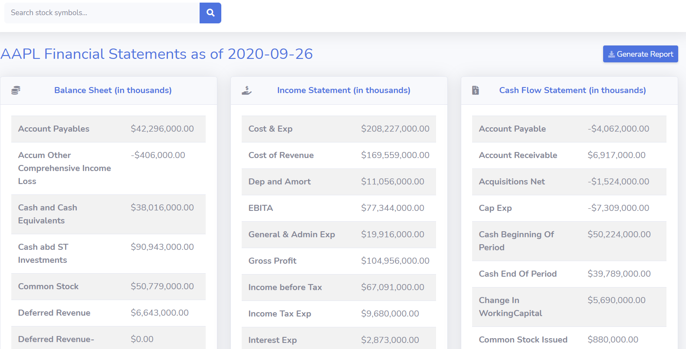
Financial Statements

Slide 6

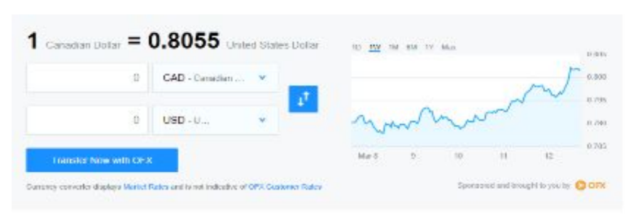
Future Development Plan
Foreign Exchange Page
Give the user the ability to convert a selected stock into the currency they are looking to purchase based on the currency exchange rate).
Commodity & Derivatives Page
Allow users to select specific commodity and obtain its current trading price and see how the specific commodity or fund has been performing recently.

